Slide 1
Chapter 5.8 SUBTRACTION OF POLYNOMIALS
Algebra concepts

Slide 2
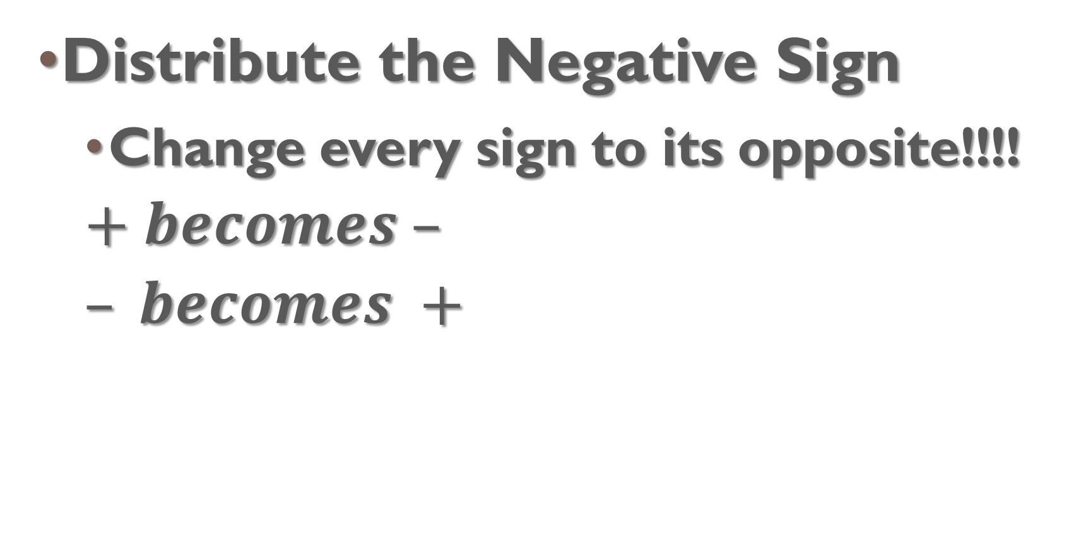
Subtracting
Distribute the Negative Sign
  Change every sign to its opposite!!!!
  $$+ becomes –$$
  $$– becomes +$$

Slide 3
Example 1

Slide 4
Example 2

Slide 5
Example 3

